Slide 1
Recovery System
Instructor: Dr. Sonam Nahar

Slide 2
Introduction
A computer system is subject to failure from a variety of causes: disk crash, power outage, software error, a fire in the machine room, etc.
Failure may result in information loss.
Therefore, the database system must take actions in advance to ensure that the atomicity and durability properties of transactions, are preserved.
Recovery scheme restore the database to the consistent state that existed before the failure.

Slide 3
Failure Classification
Transaction failure :
  Logical errors: transaction cannot complete due to some internal error condition, such as bad input, data not found, overflow, or resource limit exceeded.
  System errors: the database system must terminate an active transaction due to an error condition (e.g., deadlock)
System crash: a power failure or other hardware or software failure causes the system to crash.
  Fail-stop assumption: non-volatile storage contents are assumed to not be corrupted by system crash
    Database systems have numerous integrity checks to prevent corruption of disk data
Disk failure: a head crash or similar disk failure destroys all or part of disk storage
  Copies of the data on other disks, or archival backups on tertiary media, such as tapes, are used to recover from the failure.

Slide 4
Recovery Algorithms
To determine how the system should recover from failures, we need to
  identify the failure modes of those devices used for storing data.
  Consider how these failure modes affect the contents of the database.
Recovery algorithms are techniques to ensure database consistency and transaction atomicity and durability despite failures
  Focus of this chapter
Recovery algorithms have two parts
  Actions taken during normal transaction processing to ensure enough information exists to recover from failures
  Actions taken after a failure to recover the database contents to a state that ensures atomicity, consistency and durability

Slide 5
Storage Structure
Volatile storage:
  does not survive system crashes
  examples: main memory, cache memory
Nonvolatile storage:
  survives system crashes
  examples: disk, tape, flash memory,
  non-volatile (battery backed up) RAM
Stable storage:
  a mythical form of storage that survives all failures (no information loss).
  approximated by maintaining multiple copies on distinct nonvolatile media

Slide 6
Stable-Storage Implementation
Maintain multiple copies of each block on separate disks
  copies can be at remote sites to protect against disasters such as fire or flooding.
Failure during data transfer can still result in inconsistent copies: Block transfer can result in
  Successful completion
  Partial failure: destination block has incorrect information
  Total failure: destination block was never updated
Protecting storage media from failure during data transfer (one solution):
  Execute output operation as follows (assuming two copies of each block):
    Write the information onto the first physical block.
    When the first write successfully completes, write the same information onto the second physical block.
    The output is completed only after the second write successfully completes.

Slide 7
Stable-Storage Implementation (Cont.)
Protecting storage media from failure during data transfer (cont.):
Copies of a block may differ due to failure during output operation. To recover from failure:
  First find inconsistent blocks:
    Expensive solution: Compare the two copies of every disk block.
    Better solution:
      Record in-progress disk writes on non-volatile storage (Non-volatile RAM or special area of disk).
      Use this information during recovery to find blocks that may be inconsistent, and only compare copies of these.
      Used in hardware RAID systems
  If either copy of an inconsistent block is detected to have an error (bad checksum), overwrite it by the other copy. If both have no error, but are different, overwrite the second block by the first block.

Slide 8
Data Access
Physical blocks are those blocks residing on the disk.
Buffer blocks are the blocks residing temporarily in main memory.
Block movements between disk and main memory are initiated through the following two operations:
  input(B) transfers the physical block B to main memory.
  output(B) transfers the buffer block B to the disk, and replaces the appropriate physical block there.
Each transaction T_{i} has its private work-area in which local copies of all data items accessed and updated by it are kept.
  T_{i}'s local copy of a data item X is called x_{i}.
We assume, for simplicity, that each data item fits in, and is stored inside, a single block.

Slide 9
Data Access (Cont.)
Transaction transfers data items between system buffer blocks and its private work-area using the following operations :
  read(X) assigns the value of data item X to the local variable x_{i}.
  write(X) assigns the value of local variable x_{i} to data item {X} in the buffer block.
  both these commands may necessitate the issue of an input(B_{X}) instruction before the assignment, if the block B_{X} in which X resides is not already in memory.
Transactions
  Perform read(X) while accessing X for the first time;
  All subsequent accesses are to the local copy.
  After last access, transaction executes write(X).
output(B_{X}) need not immediately follow write(X). System can perform the output operation when it deems fit.

Slide 10
Example of Data Access
buffer
Buffer Block A
input(A)
X
A
Buffer Block B
Y
B
output(B)
read(X)
write(Y)
x₂
x₁
y₁
work area
of T₁
work area
of T₂
memory
disk

Slide 11
Recovery and Atomicity
Modifying the database without ensuring that the transaction will commit may leave the database in an inconsistent state.
Consider transaction T_{i} that transfers $50 from account A to account B; goal is either to perform all database modifications made by T_{i} or none at all.
Several output operations may be required for T_{i} (to output A and B). A failure may occur after one of these modifications have been made but before all of them are made.

Slide 12
Recovery and Atomicity (Cont.)
To ensure atomicity despite failures, we first output information describing the modifications to stable storage without modifying the database itself.
We study two approaches:
  log-based recovery, and
  shadow-paging
We assume (initially) that transactions run serially, that is, one after the other.

Slide 13
Log-Based Recovery
A log is kept on stable storage.
  The log is a sequence of log records, and maintains a record of update activities on the database.
An update log record describes a single database write. It has these fields:
  Transaction identifier is the unique identifier of the transaction that performed the write operation.
  Data-item identifier is the unique identifier of the data item written. Typically, it is the location on disk of the data item.
  Old value is the value of the data item prior to the write.
  New value is the value that the data item will have after the write.

Slide 14
Log-Based Recovery
We denote the various types of log records as:
  <T_{i} start>. Transaction T_{i} has started.
  <T_{i}, X_{i}, V₁, V₂>. Transaction T_{i} has performed a write on data item X_{i} . X_{i} had value V₁ before the write, and will have value V₂ after the write.
  <T_{i} commit>. Transaction T_{i} has committed.
  <T_{i} abort>. Transaction T_{i} has aborted.
Whenever a transaction performs a write, it is essential that the log record for that write be created before the database is modified.
For log records to be useful for recovery from system and disk failures, the log must reside in stable storage.
Two approaches using logs
  Deferred database modification
  Immediate database modification

Slide 15
Deferred Database Modification
The deferred database modification scheme records all modifications to the log, but defers all the writes to after partial commit.
Assume that transactions execute serially.
When a transaction partially commits, the information on the log associated with the transaction is used in executing the deferred writes. If the system crashes before the transaction completes its execution, or if the transaction aborts, then the information on the log is simply ignored.
The execution of transaction T_{i} proceeds as follows.
  Transaction starts by writing <T_{i} start> record to log.
  A write(X) operation results in a log record <T_{i}, X, V> being written, where V is the new value for X
  Note: old value is not needed for this scheme
  The write is not performed on X at this time, but is deferred.
  When T_{i} partially commits, <T_{i} commit> is written to the log
  Finally, the log records are read and used to actually execute the previously deferred writes.

Slide 16
Deferred Database Modification (Cont.)
During recovery after a crash, a transaction needs to be redone if and only if both <T_{i} start> and<T_{i} commit> are there in the log.
Redoing a transaction T_{i} ( redoT_{i}) sets the value of all data items updated by the transaction to the new values.
Crashes can occur while
  the transaction is executing the original updates, or
  while recovery action is being taken
example transactions T₀ and T₁ (T₀ executes before T₁):
T₀: read (A) T₁ : read (C)
A: - A - 50 C:- C- 100
Write (A) write (C)
read (B)
B:- B + 50
write (B)

Slide 17
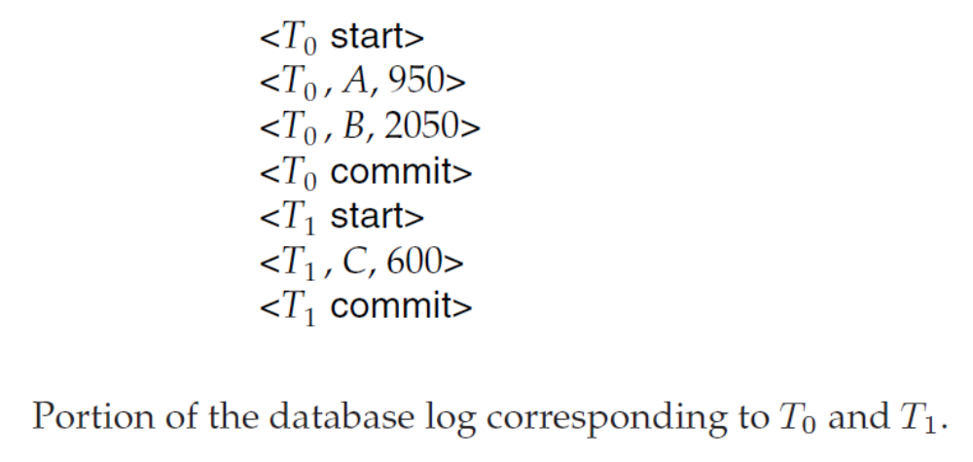
Deferred Database Modification (Cont.)
Suppose the values of accounts A, B, and C before the execution took place were $1000, $2000, and $700, respectively.

Slide 18
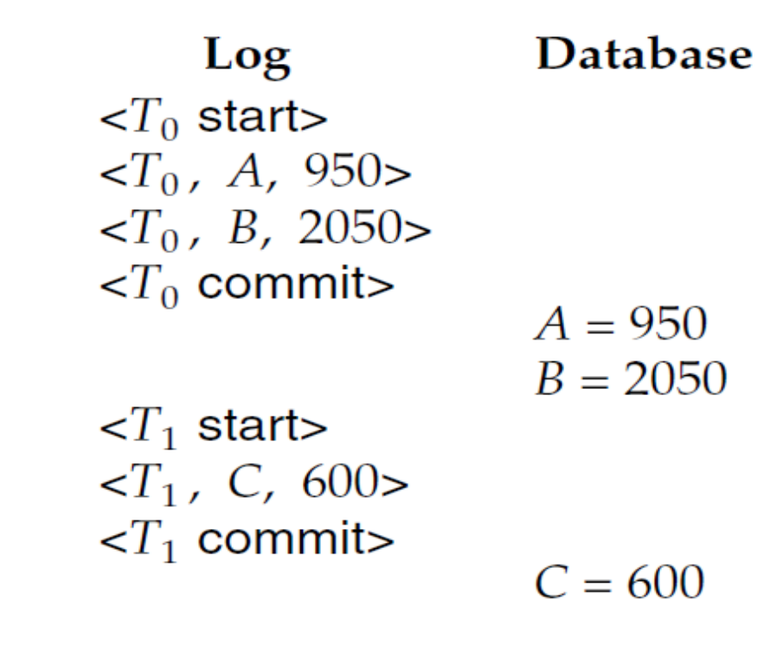
Deferred Database Modification (Cont.)
There are various orders in which the actual outputs can take place to both the database system and the log as a result of the execution of T₀ and T₁
Example state:.

Slide 19

Deferred Database Modification (Cont.)
Below we show the log as it appears at three instances of time.
After the recovery, the log record of incomplete transaction can be deleted from the log.
If log on stable storage at time of crash is as in case:
(a) No redo actions need to be taken
(b) redo(T₀) must be performed since <T₀ commit> is present
(c) redo(T₀) must be performed followed by redo(T₁) since
<T₀ commit> and <T_{i} commit> are present

Slide 20
Immediate Database Modification
The immediate database modification scheme allows database updates of an uncommitted transaction to be made as the writes are issued
  since undoing may be needed, update logs must have both old value and new value
Update log record must be written before database item is written
  We assume that the log record is output directly to stable storage
  Can be extended to postpone log record output, so long as prior to execution of an output(B) operation for a data block B, all log records corresponding to items B must be flushed to stable storage
Output of updated blocks can take place at any time before or after transaction commit
Order in which blocks are output can be different from the order in which they are written.

Slide 21
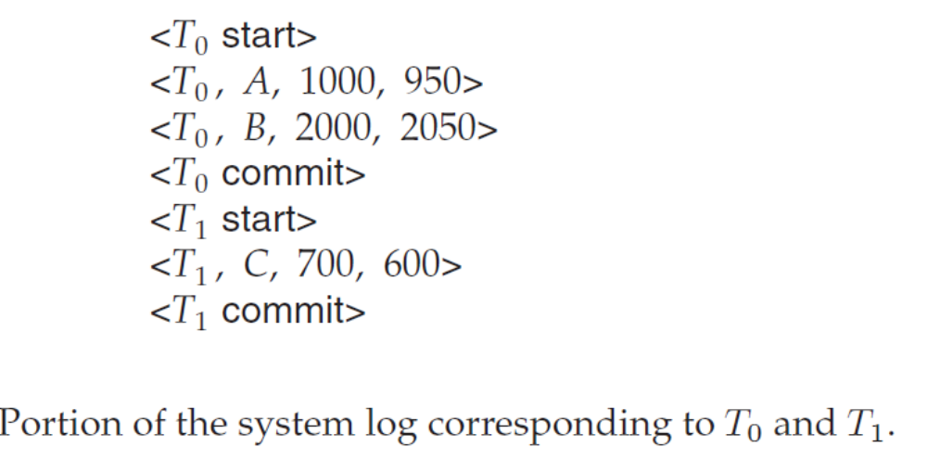
Immediate Database Modification Example

Slide 22
Immediate Database Modification Example
Log Write
<T₀ start>
<T₀, A, 1000, 950>
T_{o}, B, 2000, 2050
A = 950
B = 2050
<T₀ commit>
<T₁ start>
<T₁, C, 700, 600>
C = 600
<T₁ commit>
Note this order could not be obtained in the deferred-modification technique

Slide 23
Immediate Database Modification (Cont.)
Recovery procedure has two operations instead of one:
  undo(T_{i}) restores the value of all data items updated by T_{i} to their old values, going backwards from the last log record for T_{i}. Each time a data item X is restored to its old value V and a special log record (called redo-only) <T_{i} , X, V> is written out. When undo of a transaction is complete, a log record <T_{i} abort> is written out (to indicate that the undo was completed)
  redo(T_{i}) sets the value of all data items updated by T_{i} to the new values, going forward from the first log record for T_{i} . No logging is done in this case

Slide 24
Immediate Database Modification (Cont.)
Both operations must be idempotent
  That is, even if the operation is executed multiple times the effect is the same as if it is executed once
    Needed since operations may get re-executed during recovery
When recovering after failure:
  Transaction T_{i} needs to be undone if the log contains the record
  <T_{i} start>, but does not contain the record <T_{i} commit>.
  Transaction T_{i} needs to be redone if the log contains both the record <T_{i} start> and the record <T_{i} commit>.
Undo operations are performed first, then redo operations.

Slide 25
Immediate Database Modification (Cont.)
The undo and redo operations are used in several different circumstances:
  The undo is used for transaction rollback during normal operation(in case a transaction cannot complete its execution due to some logical error).
  The undo and redo operations are used during recovery from failure.
We need to deal with the case where during recovery from failure another failure occurs prior to the system having fully recovered.

Slide 26
Transaction rollback (during normal operation)
Let T_{i} be the transaction to be rolled back
Scan log backwards from the end, and for each log record of T_{i} of the form <T_{i}, X_{j}, V₁, V₂>
  Perform the undo by writing V₁ to X_{j},
  Write a log record <T_{i} , X_{j}, V₁>
    such log records are called compensation log records
Once the record <T_{i} start> is found stop the scan and write the log record <T_{i} abort>

Slide 27
Undo and Redo on Recovering from Failure
When recovering after failure:
  Transaction T_{i} needs to be undone if the log
    contains the record <T_{i} start>,
    but does not contain either the record <T_{i} commit> or <T_{i} abort>.
  Transaction T_{i} needs to be redone if the log
    contains the records <T_{i} start>
    and contains the record <T_{i} commit> or <T_{i} abort>
  It may seem strange to redo transaction T_{i} if the record <T_{i} abort> record is in the log. To see why this works, note that if <T_{i} abort> is in the log, so are the redo-only records written by the undo operation. Thus, the end result will be to undo T_{i} 's modifications in this case. This slight redundancy simplifies the recovery algorithm and enables faster overall recovery time.
    such a redo redoes all the original actions including the steps that restored old value. Known as repeating history

Slide 28

Immediate Modification Recovery Example
Below we show the log as it appears at three instances of time.
Recovery actions in each case above are:
(a) undo (T₀): B is restored to 2000 and A to 1000, and log records
<T₀, B, 2000>, <T₀, A, 1000>, <T₀, abort> are written out
(b) redo (T₀) and undo (T₁): A and B are set to 950 and 2050 and C is restored to 700. Log records <T₁, C, 700>, <T₁, abort> are written out.
(c) redo (T₀) and redo (T₁): A and B are set to 950 and 2050
respectively. Then C is set to 600

Slide 29
Checkpoints
Problems in recovery procedure as discussed earlier :
  searching the entire log is time-consuming
  we might unnecessarily redo transactions which have already output their updates to the database.
Streamline recovery procedure by periodically performing checkpointing
  Output all log records currently residing in main memory onto stable storage.
  Output all modified buffer blocks to the disk.
  Write a log record < checkpoint> onto stable storage.
Transactions are not allowed to perform any update actions, such as writing to a buffer block or writing a log record, while a checkpoint is in progress.
Consider a transaction T_{i} that committed prior to the checkpoint. For such a transaction, the <T_{i} commit> record appears in the log before the <checkpoint> record. Any database modifications made by T_{i} must have been written to the database either prior to the checkpoint or as part of the checkpoint itself. Thus, at recovery time, there is no need to perform a redo operation on Ti

Slide 30
Checkpoints (Cont.)
During recovery we need to consider only the most recent transaction T_{i} that started before the checkpoint, and transactions that started after T_{i}.
  Scan backwards from end of log to find the most recent <checkpoint> record
  Continue scanning backwards till a record <T_{i} start> is found.
  Need only consider the part of log following above start record. Earlier part of log can be ignored during recovery, and can be erased whenever desired.
  For all transactions (starting from T_{i} or later) with no <T_{i} commit>, execute undo(T_{i}). (Done only in case of immediate modification.)
  Scanning forward in the log, for all transactions starting from T_{i} or later with a <T_{i} commit>, execute redo(T_{i}).

Slide 31
Example of Checkpoints
T_{c}
T_{f}
T₁ can be ignored (updates already output to disk due to checkpoint)
T₂ and T₃ redone.
T₄ undone
T₁
T₂
T₃
T₄
checkpoint
system failure

Slide 32
Recovery With Concurrent Transactions
We modify the log-based recovery schemes to allow multiple transactions to execute concurrently.
  All transactions share a single disk buffer and a single log
  A buffer block can have data items updated by one or more transactions
We assume that if a transaction T_{i} has modified an item, no other transaction can modify the same item until T_{i} has committed or aborted
  i.e. the updates of uncommitted transactions should not be visible to other transactions
    Otherwise how do we perform undo if T₁ updates A, then T₂ updates A and commits, and finally T₁ has to abort?
  Can be ensured by obtaining exclusive locks on updated items and holding the locks till end of transaction (strict two-phase locking)
Log records of different transactions may be interspersed in the log.

Slide 33
Recovery With Concurrent Transactions (Cont.)
Checkpoints are performed as before, except that the checkpoint log record is now of the form
< checkpoint L>
where L is the list of transactions active at the time of the checkpoint
  We assume no updates are in progress while the checkpoint is carried out.
When the system recovers from a crash, it first does the following:
  Initialize undo-list and redo-list to empty
  Scan the log backwards from the end, stopping when the first <checkpoint L> record is found.
  For each record found during the backward scan:
    if the record is <T_{i} commit>, add T_{i} to redo-list
    if the record is <T_{i} start>, then if T_{i} is not in redo-list, add T_{i} to undo-list
  For every T_{i} in L, if T_{i} is not in redo-list, add T_{i} to undo-list

Slide 34
Recovery With Concurrent Transactions (Cont.)
At this point undo-list consists of incomplete transactions which must be undone, and redo-list consists of finished transactions that must be redone.
Recovery now continues as follows:
  Scan log backwards from most recent record, stopping when
  <T_{i} start> records have been encountered for every T_{i} in undo-list.
    During the scan, perform undo for each log record that belongs to a transaction in undo-list.
  Locate the most recent <checkpoint L> record.
  Scan log forwards from the <checkpoint L> record till the end of the log.
    During the scan, perform redo for each log record that belongs to a transaction on redo-list

Slide 35
Example of Recovery
Go over the steps of the recovery algorithm on the following log:
        <T₀ start>
        <T₀, A, 0, 10>
        <T₀ commit>
        <T₁ start> /* Scan at step 1 comes up to here */
        <T₁, B, 0, 10>
        <T₂ start>
        <T₂, C, 0, 10>
        <T₂, C, 10, 20>
        <checkpoint {T₁, T₂}>
        <T₃ start>
        <T₃, A, 10, 20>
        <T₃, D, 0, 10>
        <T₃ commit>

Slide 36
Recovery Algorithm
Logging (during normal operation):
  <T_{i} start> at transaction start
  <T_{i}, X_{j}, V₁, V₂> for each update, and
  <T_{i} commit> at transaction end
Transaction rollback (during normal operation)
  Let T_{i} be the transaction to be rolled back
  Scan log backwards from the end, and for each log record of T_{i} of the form <T_{i}, X_{j}, V₁, V₂>
    perform the undo by writing V₁ to X_{j},
    write a log record <T_{i} , X_{j}, V₁>
      such log records are called compensation log records
  Once the record <T_{i} start> is found stop the scan and write the log record <T_{i} abort>

Slide 37
Recovery Algorithm (Cont.)
Recovery from failure: Two phases
  Redo phase: replay updates of all transactions, whether they committed, aborted, or are incomplete
  Undo phase: undo all incomplete transactions
Redo phase:
  Find last <checkpoint L> record, and set undo-list to L.
  Scan forward from above <checkpoint L> record
    Whenever a record <T_{i}, X_{j}, V₁, V₂> is found, redo it by writing V₂ to X_{j}
    Whenever a log record <T_{i} start> is found, add T_{i} to undo-list
    Whenever a log record <T_{i} commit> or <T_{i} abort> is found, remove T_{i} from undo-list

Slide 38
Recovery Algorithm (Cont.)
Undo phase:
  Scan log backwards from end
    Whenever a log record <T_{i}, X_{j}, V₁, V₂> is found where T_{i} is in undo-list perform same actions as for transaction rollback:
      perform undo by writing V₁ to X_{j}.
      write a log record <T_{i} , X_{j}, V₁>
    Whenever a log record <T_{i} start> is found where T_{i} is in undo-list,
      Write a log record <T_{i} abort>
      Remove T_{i} from undo-list
    Stop when undo-list is empty
      i.e.,<T_{i} start> has been found for every transaction in undo-list
After undo phase completes, normal transaction processing can commence

Slide 39

Example of Recovery

